Slide 1
Math 642: Introduction to Machine Learning
Lecture 5: Splines, Generalized Additive Models,
Gradient Descent
February 12, 2020
Some of the figures in this presentation are taken from "An Introduction to Statistical Learning, with applications in R" (Springer, 2013) with permission from the authors: G. James, D. Witten, T. Hastie and R. Tibshirani

Slide 2
Class Schedule
Lec | Date | Lecture | Due
1 | Jan 15 | Intro, Linear Regression, Bias and Variability
2 | Jan 22 | Unsupervised Learning: Clustering, Principle Comp. Analysis | Hwk 1
3 | Jan 29 | KNN Regression, Cross Validation, Bootstrap | Hwk 2
4 | Feb 5 | Ridge Regression, LASSO, Principle Components Regression | Hwk 3
5 | Feb 12 | Extreme Nonlinear: Step Functions, Splines, Gradient Descent | Hwk 4, Project Plan
6 | Feb 19 | Classification, Logistic Regression | Hwk 5
7 | Feb 26 | Discriminant Analysis, Support Vector Machines | Hwk 6, Plan Revision
 | Mar 4 | Mid Term Exam
 | Mar 11 | Spring Break
8 | Mar 18 | Tree-Based Methods | Hwk 7
9 | Mar 25 | Neural Networks, Deep Learning | Hwk 8
10 | Apr 1 | Convolutional Neural Networks | Hwk 9
11 | Apr 8 | Bayesian Analysis, Project Presentations | Final Project Due
12 | Apr 15 | Time Series, Project Presentations | Hwk 10
13 | Apr 22 | Ethics of Machine Learning, Project Presentations | Hwk 11
 | Apr 29 | Study Day
 | May 6 | Final Exam

Slide 3
Machine Learning Taxonomy
Statistical Learning
Outcomes
No Outcomes
Supervised
Unsupervised
Quantitative
Estimation
Outcome
is a Number
Outcome
is a Class
Classification
Clustering
Principal
Components
Logistic Regression
Parametric
Estimation
Non-Parametric
Estimation
Bayesian Belief Network
LDA/QDA
y = f(x)
non-equation
based
KNN Classification
Common Elements
Cross Validation
Feature Selection
Gradient Descent
Bootstrap
Boosting
Linear Regression
SVM
KNN Regression
Ridge Regression
Clustering
Decision Trees
LASSO
Decision Trees
Bayesian Analysis
Splines
Time Series
Neural Nets

Slide 4
Review from Last Week

Slide 5
Fixes for the Curse of Dimensionality
Fixes fall into three general categories:
Pick only the features that contribute to the outcome. Eliminate some features that do not effect outcome
Best Subset
Forward and backward stepwise
LASSO
“Shrink” the effect of the features by limiting the magnitude of the coefficients
Ridge Regression (also called “Regularization”)
Combine features into a smaller set of orthogonal basis vectors
Principle Components Analysis

Slide 6
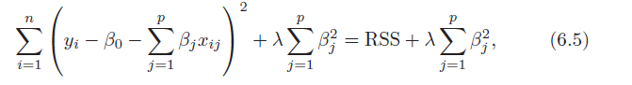
Ridge Regression
Limits the sum of the β² to a constant (not including β₀). This has the effect of “reducing variability” of the fit.
Maintains all the same features
Maintains their relative importance
Reduces their influence
Results: Like a low-pass filter in Electrical Engineering. “Smooths out” the fit to reduce overfitting (controlled by λ)

Slide 7
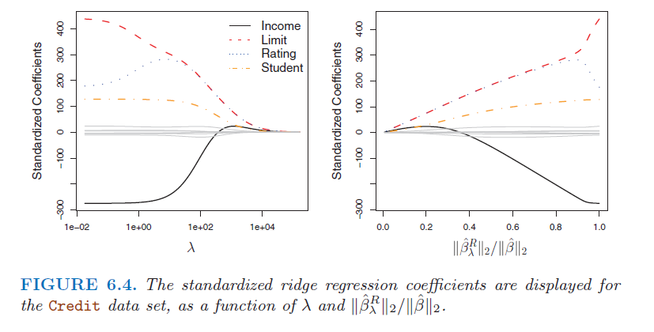
Ridge Regression
When λ = 0, there is no penalty for flexibility and the model reverts to the original solution.
As λ gets larger, the coefficients get smaller.
When λ = infinity, the coefficients go to zero and you get the null model.

Slide 8
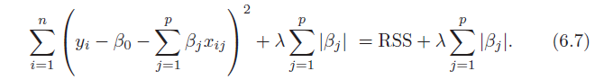
LASSO
Limits the sum of the abs(β) to a constant (not including β₀). This has the effect of “reducing variability” of the fit by eliminating some features.
Can reduce the number of features
Can change the relative importance of features
Can change influence of features
Results: Best way to smooth out the fit and reduce overfitting… but of course can increase bias if taken too far (controlled by λ)

Slide 9
Ridge Regression
When λ = 0, there is no penalty for flexibility and the model reverts to the original solution.
As λ gets larger, some coefficients go to zero.
When λ = infinity, all the coefficients go to zero and you get the null model.

Slide 10
Principal Component Analysis
The new axes are combinations of the original axes
Linear combination means you multiply one or more of the original axes by a constant and add the result
Normal means the sum of squares for the constants is 1
Orthogonal means that the axes are independent ( mathematically it means they intersect at 90 degrees)

Slide 11
Principle Components Regression
Just like we did for linear regression, use the Z features to create a least squares model. Use K of these principle components.
The net effect is a reduction from p features to p-k features, where p-k is the number of basis vectors.
Since each basis vector accounts for a different amount of variability, you can choose when to cutoff the features based on this criteria.

Slide 12
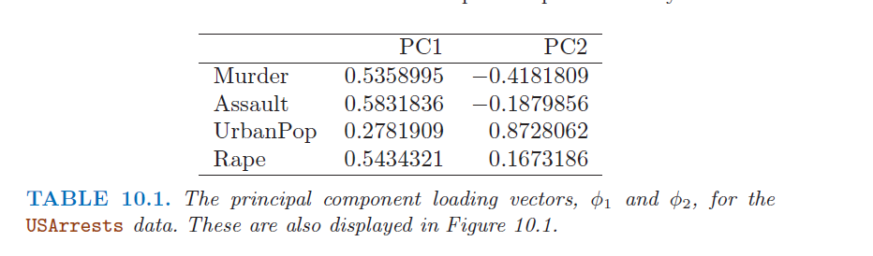
Principal Components
Principal Components Analysis creates a low dimensional representation of the data capturing as much information as possible.
The following is built from a dataset of arrests per 100,000 arrests in 50 states for 3 crimes, plus the state’s percentage of the population living in a city.

Slide 13
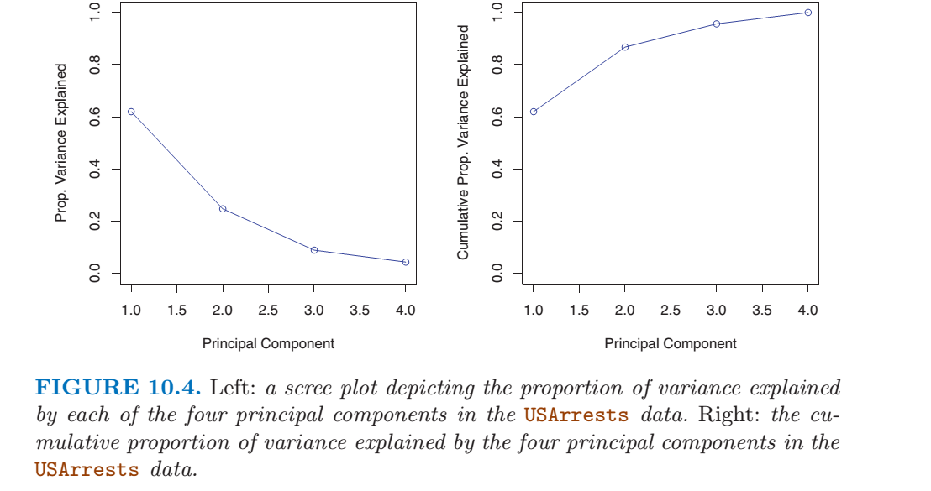
PVE

Slide 14
Splines – Chapter 7

Slide 15
Non-Linearity in Modeling
Some data is extremely nonlinear and the methods we’ve looked at so far just don’t do a good job modeling reality. This is a polynomial fit with order = 4.

Slide 16
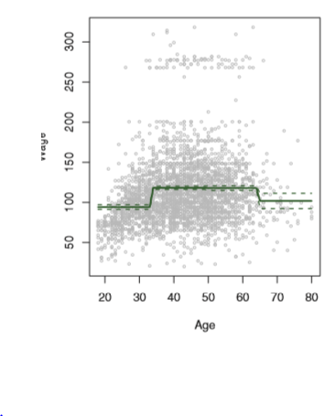
Linear Step Models
This data clearly has discontinuities where additional factors need to be considered. For the ager older than 30, there are high earners. Above 65 they disappear.
You can split up the range and model them independently
y_{i} = β₀₁ + β₁₁ ∗ x_{i} for x_{i} ≤ c₁
y_{i} = β₀₂ + β₁₂ ∗ x_{i} for c₁ ≤ x_{i} ≤ c₂
y_{i} = β₀₃ + β₁₃ ∗ x_{i} for x_{i} ≥ c₂

Slide 17
Piecewise Polynomial Models
Q: What if the outcome does not look to be the same order of x_{ij} over the entire range of the features?
You can split up the range and model them (almost) independently
y_{i} = β₀₁ + β₁₁ ∗ x_{i} + β₂₁ ∗ x_{i}² for x_{i} ≤ c
y_{i} = β₀₂ + β₁₂ ∗ x_{i} + β₂₂ ∗ x_{i}² + β₃₂ ∗ x_{i}³ for x_{i} ≤ c
Why not just use a higher order polynomial for the entire dataset?
Using one function could result in a very high order model. Because splitting up the function can lower the model dimensionality and complexity.
^
^
^
^
^
^
^
^

Slide 18
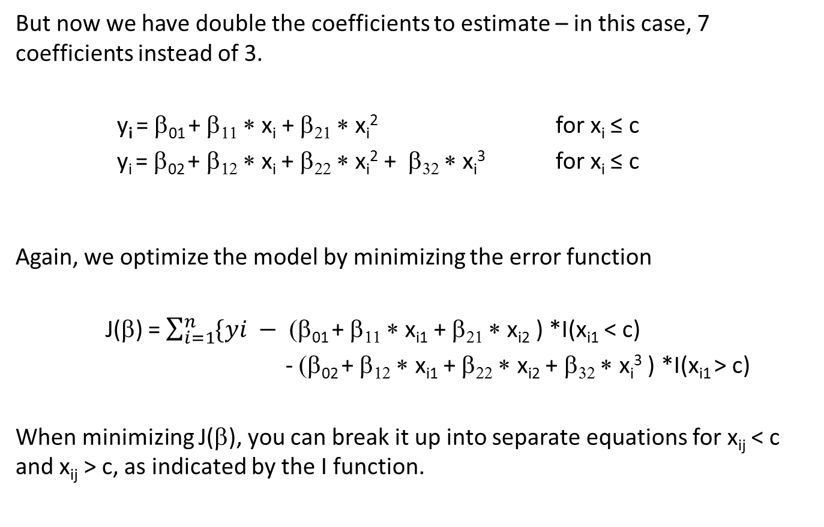
Piecewise Polynomial Models
But now we have double the coefficients to estimate – in this case, 7 coefficients instead of 3.
y_{i} = β₀₁ + β₁₁ ∗ x_{i} + β₂₁ ∗ x_{i}² for x_{i} ≤ c
y_{i} = β₀₂ + β₁₂ ∗ x_{i} + β₂₂ ∗ x_{i}² + β₃₂ ∗ x_{i}³ for x_{i} ≤ c
Again, we optimize the model by minimizing the error function
J(β) = $\sum_{i=1}^{n}{\{yi − }$ (β₀₁ + β₁₁ ∗ x_{i1} + β₂₁ ∗ x_{i2} ) *I(x_{i1} < c)
- (β₀₂ + β₁₂ ∗ x_{i1} + β₂₂ ∗ x_{i2} + β₃₂ ∗ x_{i}³ ) *I(x_{i1} > c)
When minimizing J(β), you can break it up into separate equations for x_{ij} < c and x_{ij} > c, as indicated by the I function.
^
^
^
^
^
^
^
^
^
^
^
^
^
^

Slide 19
Knots
There can be one or more “break points” called knots. In general the more knots you have the more flexible the fit.
The complexity here is to determine
How many knots there should be?
Where to put them
Approach for specifying knots:
You can use trial and error with Cross Validation. You can plot the errors and see where the errors are greatest (may need more knots).
Once you figure out the number of knots, you can
specify the Degrees of Freedom and let the software place the knots uniformly, or
Specify where you want the knots

Slide 20
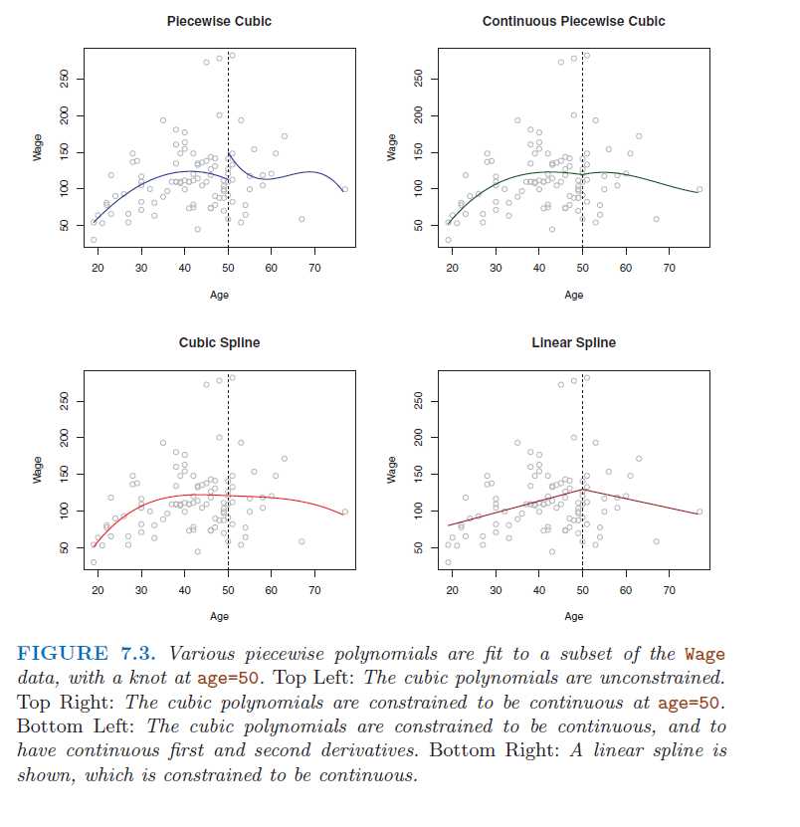
Examples of Discontinuities

Slide 21
Degrees of Freedom
The Degrees of Freedom (DOF) for a model is equal to the number of coefficients you have that are free to vary in order to minimize the error.
For a linear model with 1 feature, DOF = 2 (constant plus the coefficient)
For a cubic model with 1 feature, DOF = 4 (constant plus 3 coefficients)
For a cubic model with 1 knot and no other constraints, DOF = 8 (2 constants plus 6 coefficients)

Slide 22
Basis Functions
We need to choose a coordinate system for our models
The most obvious choice for basis functions for our models are the predictors X₁, X₂, …, X_{p}
But these aren’t always the best choice
They may force a higher-dimensional model than necessary
They may be corelated to one another
They may make analysis more complicated than necessary
In general mathematical terms, you can construct functions which
Are orthogonal to one another = no correlation between basis vectors
Are low dimension across a subset of the whole range
Render complicated analysis simple

Slide 23
Basis Vectors
Instead of using the features x_{ij}, use orthogonal and normal combinations of the features. Define some function b(x) as basis vectors
For splines, it turns out that a good representation for the basis vector is
The DOF for a cubic spline is (again) 4 + k, where k is the number of knots

Slide 24
Degrees of Freedom for Cubic Spline
The degrees of freedom (DOF) for a model is equal to the number of coefficients you have that are free to vary in order to minimize the error minus the number of constraints.
For a linear model with 1 knot, there are 2 lines and 4 DOF
If the lines are forced to be continuous at the knot then the DOF = 3
For a cubic polynomial model with 1 knot, DOF = 8
For a cubic spline with 1 knot that is constrained to be
Continuous value, DOF = 7
Continuous value and continuous first derivative (slope), DOF = 6
Continuous value, first derivative, second derivative, DOF = 5

Slide 25
Splines
Regression splines are a system of basis functions that can be used to represent discontinuous data. A spline is a linear or polynomial model continuous at derivative d-1 levels at all knots.
Thus a cubic spline is a polynomial model of degree 3 that is continuous at derivative 0 (the value at the knot), derivative 1 (slope at the knot), and derivative 2 (change in slope at the knot)

Slide 26
Cubic Spline
A cubic spline with no knots is just a cubic polynomial
Two Cubic polynomials with a knot at c would be
(page 271)
A cubic spline with a knot are 2 separate 3rd order polynomials that fit together smoothly
y_{i} = (β₀₁x_{i} + β₁₁x_{i} + β₂₁x_{i}² + β₃₁x_{i}³ )*I(x < c) +
(β₀₂x_{i} + β₁₂x_{i} + β₂₂x_{i}² + β₃₂x_{i}³ )*I(x > c) + β₄(x − x_{c})³* I(x > c)
(Eqs. 7.9,7.10)

Slide 27
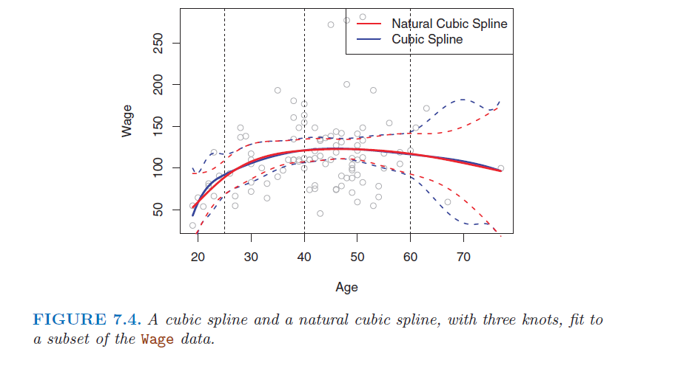
Natural Cubic Splines
Sometimes the cubic spline has low confidence on the edges, and the estimate goes unstable. Natural cubic splines have an added constraint that the function must be linear at the edge of the range.

Slide 28
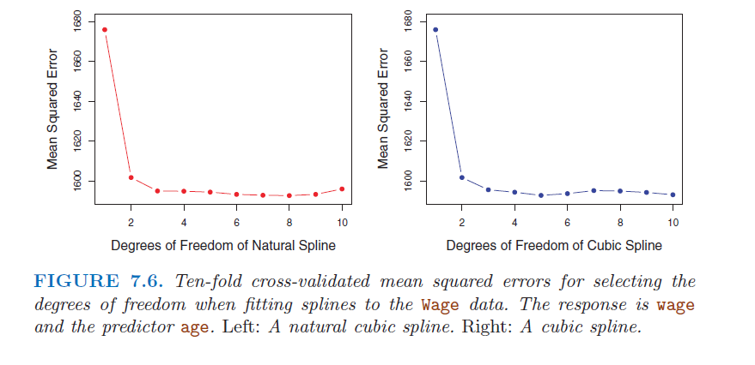
Selecting Knots
The complexity is then: How many knots do I pick, and where do I put them?
A: Specify DOF, let R space them equally, and look at the CV

Slide 29
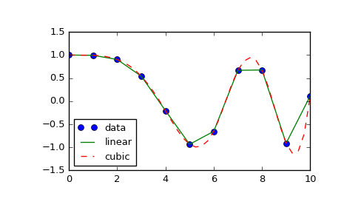
Smoothing Splines
Suppose we have an interpolation of a sample of data that is forced to go through every point.
This would require a very flexible polynomial function for a basis. Or maybe cut points at every sample. Either way it would likely badly overfit the data.
Let’s call this function that badly overfits g(x)

Slide 30
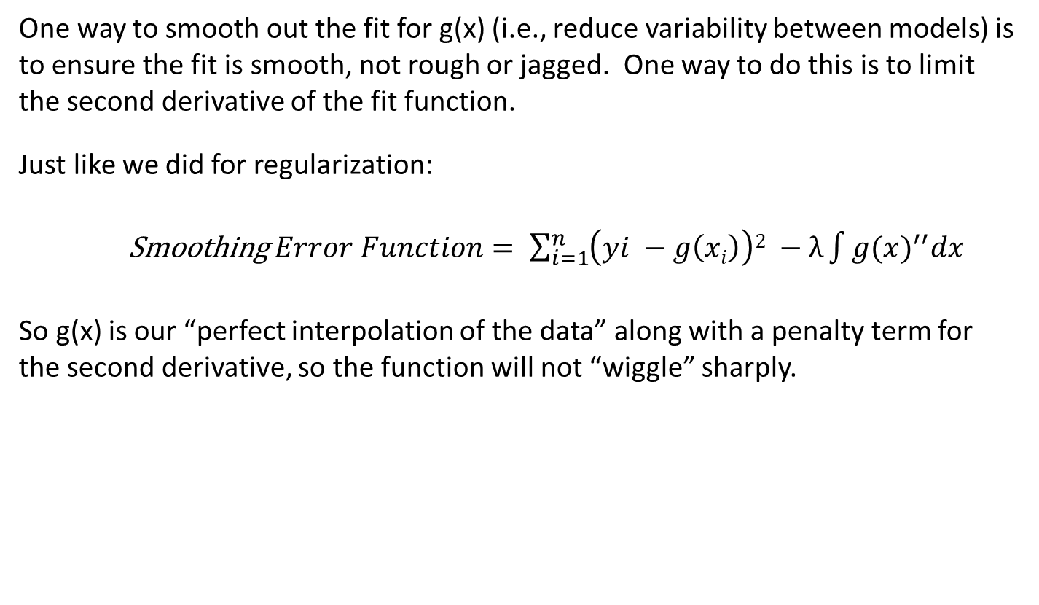
Smoothing Splines
One way to smooth out the fit for g(x) (i.e., reduce variability between models) is to ensure the fit is smooth, not rough or jagged. One way to do this is to limit the second derivative of the fit function.
Just like we did for regularization:
Smoothing $Error Function= \sum_{i=1}^{n}{\left(yi −g\left(xi\right)\right)2 −λ\int{{g(x)}^{′′}dx}}$
So g(x) is our “perfect interpolation of the data” along with a penalty term for the second derivative, so the function will not “wiggle” sharply.
^
^

Slide 31
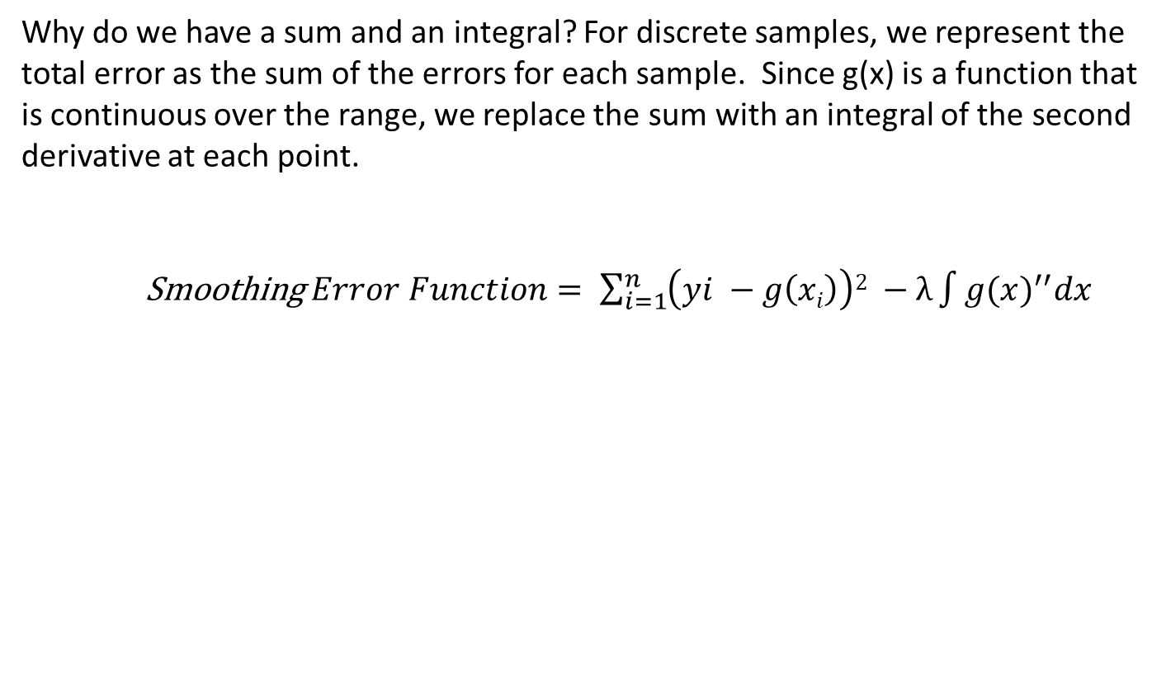
Smoothing Splines
Why do we have a sum and an integral? For discrete samples, we represent the total error as the sum of the errors for each sample. Since g(x) is a function that is continuous over the range, we replace the sum with an integral of the second derivative at each point.
Smoothing $Error Function= \sum_{i=1}^{n}{\left(yi −g\left(xi\right)\right)2 −λ\int{{g(x)}^{′′}dx}}$
^
^

Slide 32
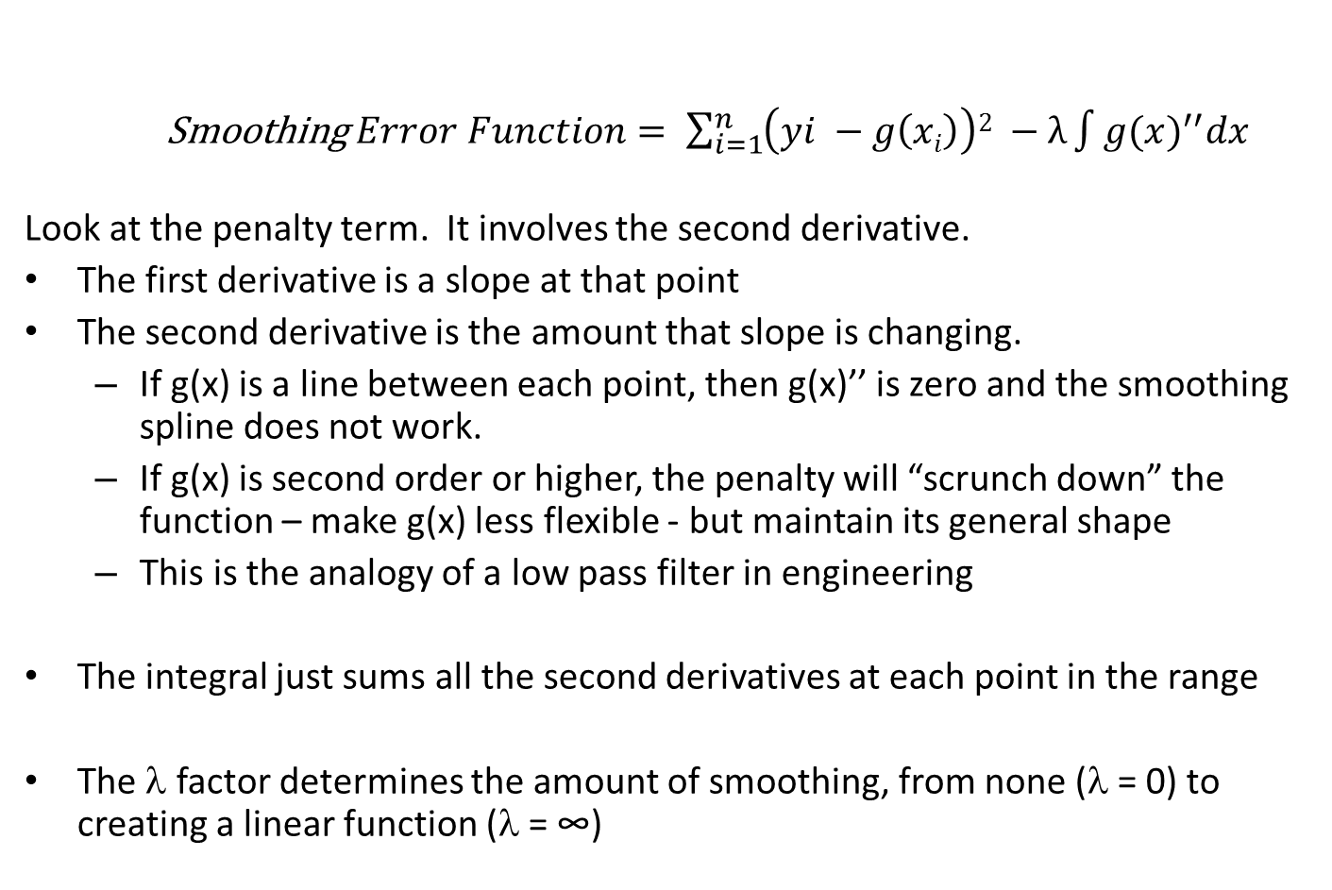
Smoothing Splines
^
^
Smoothing $Error Function= \sum_{i=1}^{n}{\left(yi −g\left(xi\right)\right)2 −λ\int{{g(x)}^{′′}dx}}$
Look at the penalty term. It involves the second derivative.
The first derivative is a slope at that point
The second derivative is the amount that slope is changing.
If g(x) is a line between each point, then g(x)’’ is zero and the smoothing spline does not work.
If g(x) is second order or higher, the penalty will “scrunch down” the function – make g(x) less flexible - but maintain its general shape
This is the analogy of a low pass filter in engineering
The integral just sums all the second derivatives at each point in the range
The λ factor determines the amount of smoothing, from none (λ = 0) to creating a linear function (λ = ∞)

Slide 33
Smoothing Splines
With smoothing splines, you avoid the main pitfall of cut points and knots
With cut points or knots, you can analyze how many degrees of freedom are optimal in several ways, but where do you put the cut points?
With a smoothing spline, you don’t have to choose the point locations, because there is a cut point for every sample.

Slide 34
Effective Degrees of Freedom
When λ = 0, there is no smoothing and the model can be wiggly. When λ = infinity, the second derivative is zero, meaning the model is a line of constant slope that passes as close as possible to the training points.
How many effective DOF does a smoothing spline have?
For λ = 0, it’s as if a cubic spline had a knot at every point. Thus DOF = n + 4
For λ = infinity, the DOF is the same as a straight line: 2
= the y-intercept and the slope

Slide 35
Choosing λ for Smoothing Splines
In R, you can construct a smoothing spline with the following command. Rather than a spline with n DOF, this function figures out the λ that corresponds to 16 DOF.
Or you can smooth the function by cross validation with the following commands:

Slide 36
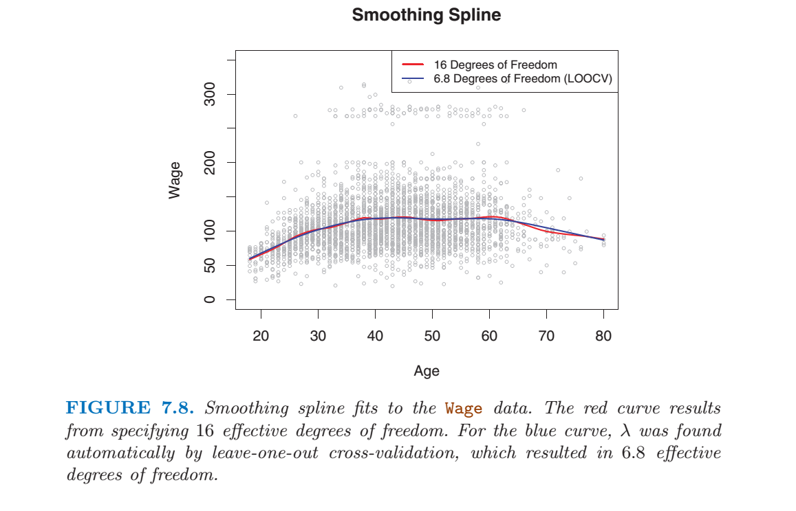
Which Model?

Slide 37
General Additive Models – 7.7

Slide 38
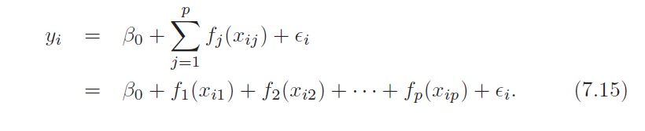
Generalized Additive Models
For multiple features, can the individual fitted functions be combined in one model?
Can we replace
with

Slide 39
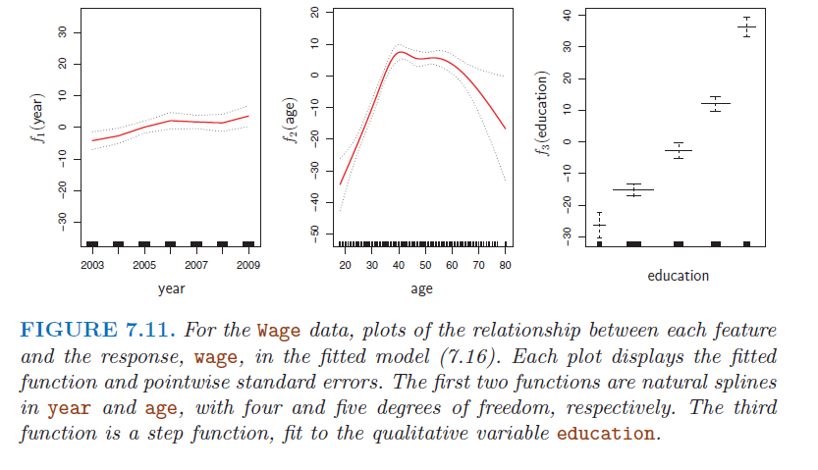
Additivity
Natural Splines (year and age) can be viewed as a sum of squares regression onto the spline basis vectors. Thus they can be combined in a regression matrix.

Slide 40
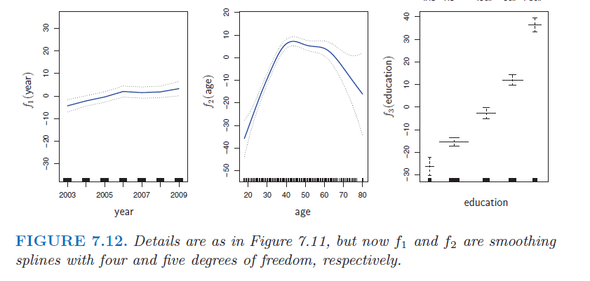
Additivity
Smoothing splines (for year and age) use different filtering for each variable to achieve smoothing. Thus they do not add as readily as natural splines. However, they can be combined using backfitting.
Backfitting is an iterative algorithm, where you model the results once with an additive model, calculate the errors (residuals), then model the residuals using a separate function. Use the gam() function. There is a homework assignment on this.

Slide 41
Basis Vectors
Note: There are other basis vectors you could choose, depending on the system you are trying to model or analyze
Basis Vector | Application | Attributes
Eigenvectors | Radar Analysis | Radar datasets are made up of returns from targets, returns from terrain, and system noise. You can derive these basis vectors from the data
Sine Waves | Time series and periodic functions | There are an infinite number of sine waves of different frequencies. You can use these to construct any signal.
Wavelets | Image data or signal compression | Wavelettes can sometimes be used to represent signals more efficiently than sine waves, so a large data file can be made smaller without losing a lot of information content.

Slide 42
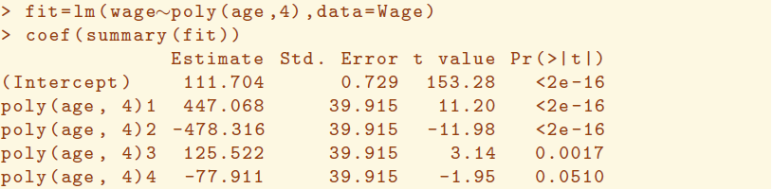
Basis Functions
We talked about independent basis functions and how they permit you to compare MSE, p, and z scores between features
If the features (basis functions) in a model are independent (orthogonal) then you can use pr(>|t|) to differentiate between features in a model.

Slide 43

Gradient Descent
This is not in the ISLR text

Slide 44
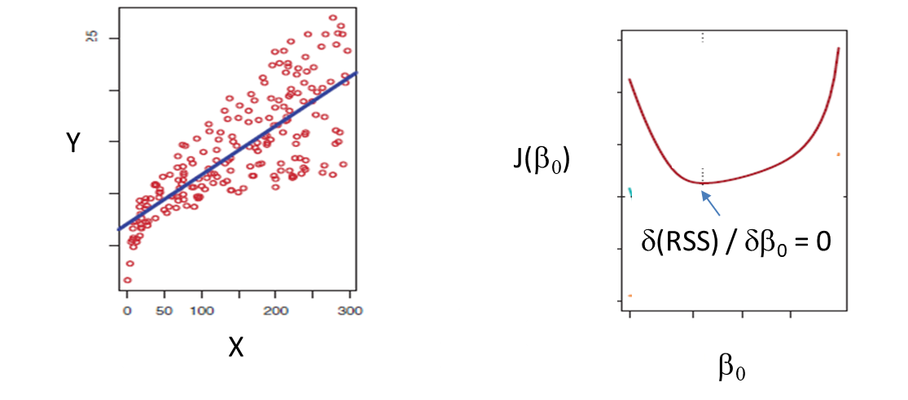
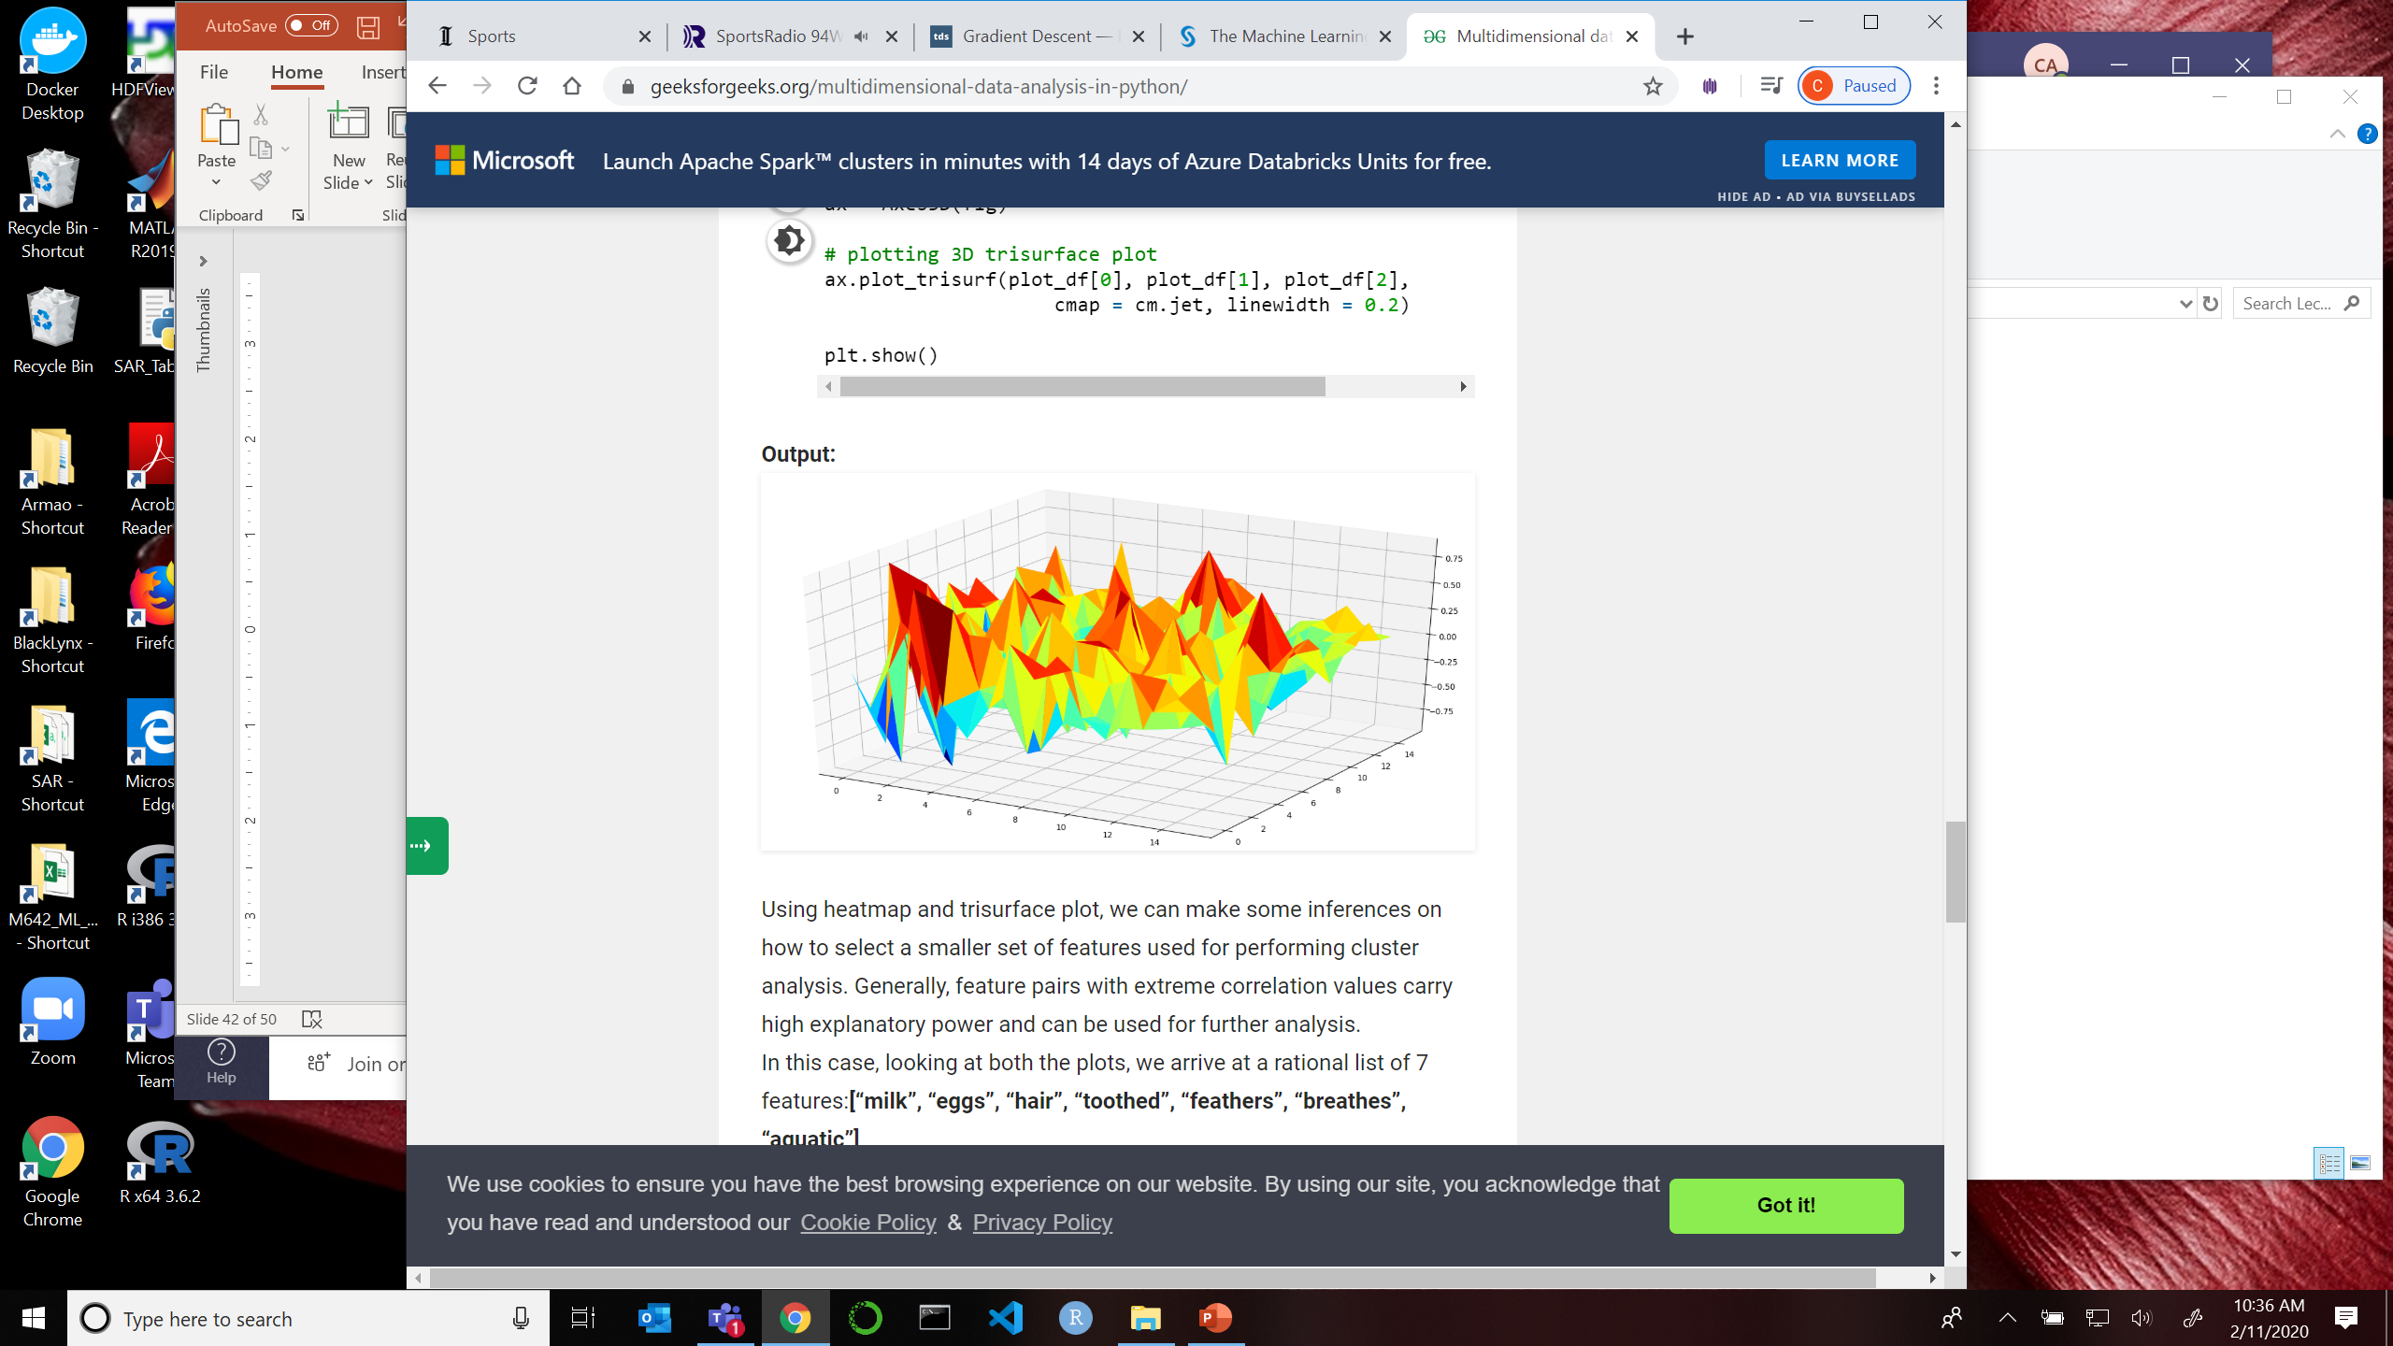
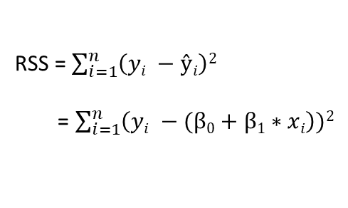
Finding the Right Modeling Parameters
Ideally you can compute the right coefficients for your model by calculating the minimum of the Error Function (that is, deterministically)
Sometimes the Error Function cannot be expressed in an equation
Spline Models with discontinuities
Smoothing Spline Models
KNN Models
Models with many (> 1000) features
So how do you find the right coefficients?
RSS = $\sum_{i=1}^{n}{\left(yi −ŷi\right)2}$
= $\sum_{i=1}^{n}{\left(yi −(β0+β1∗xi\right))2}$
RSS(β_{j})
β₂
β₁

Slide 45
Finding the Right Modeling Parameters
Remember what we are doing: We have selected a modeling method, we have selected candidate features, but we do not know the correct coefficients for our model.
For example, say we are using a cubic spline model with 5 features and 3 knots. How do we find the unique combination of 15+ coefficients that result in the minimum error?

Slide 46
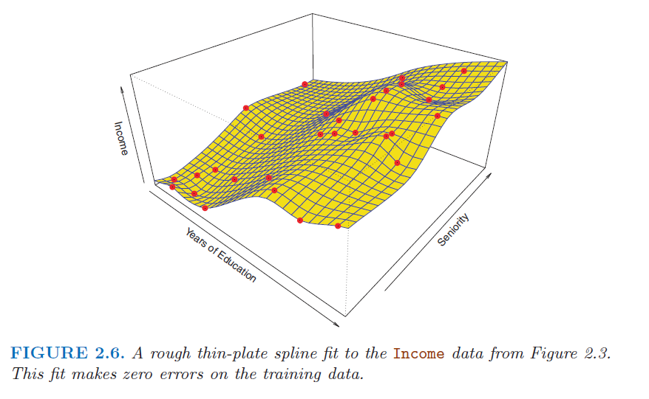
Gradient Descent
To find the minimum of a complicated error surface numerically
Select a point
Calculate the direction of minimum slope
If all slopes are positive you have found a local or global minimum
Store this minimum
Go back to 1 and pick a new starting point
Move 1 step in minimum direction
Repeat 2 and 3 until you hit a minimum
Choose the lowest value to be your Error Function Minimum
Error Function
Coefficient for Seniority
Coefficient for Years
of Education

Slide 47
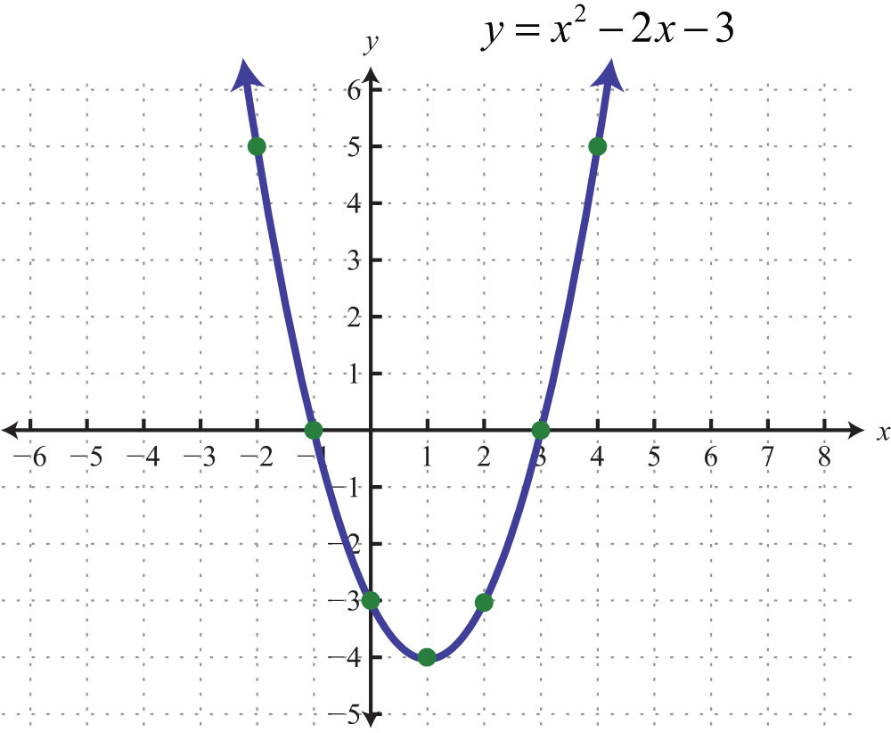
Gradient Descent in One Dimension
Select a point on the Error Function and see if the Error Function is increasing or decreasing.
Based on the sign of the slope of the Error Function, adjust β to move the Error Function in the correct direction.
Error
J = Error Function
β
δJ / δβ = slope of the Error Function with respect to the coefficient β

Slide 48
Gradient Descent in One Dimension
Now you know in which direction to move. What is the next point that you use?
If you go too far, you can work your way up the curve versus down to the minimum
If you don’t go far enough, you end up taking forever to get to the minimum
We use a learning parameter to control the speed of the solution.
J = Error Function
δJ / δβ = slope of the Error Function with respect to the feature β

Slide 49
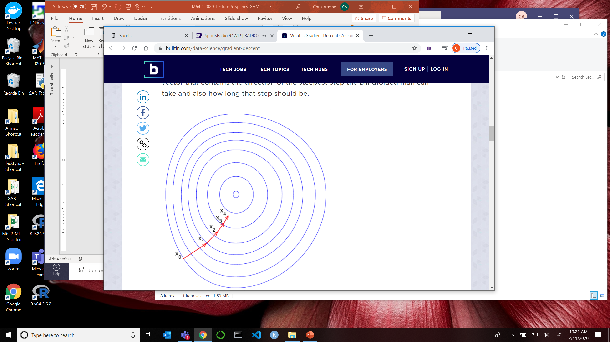
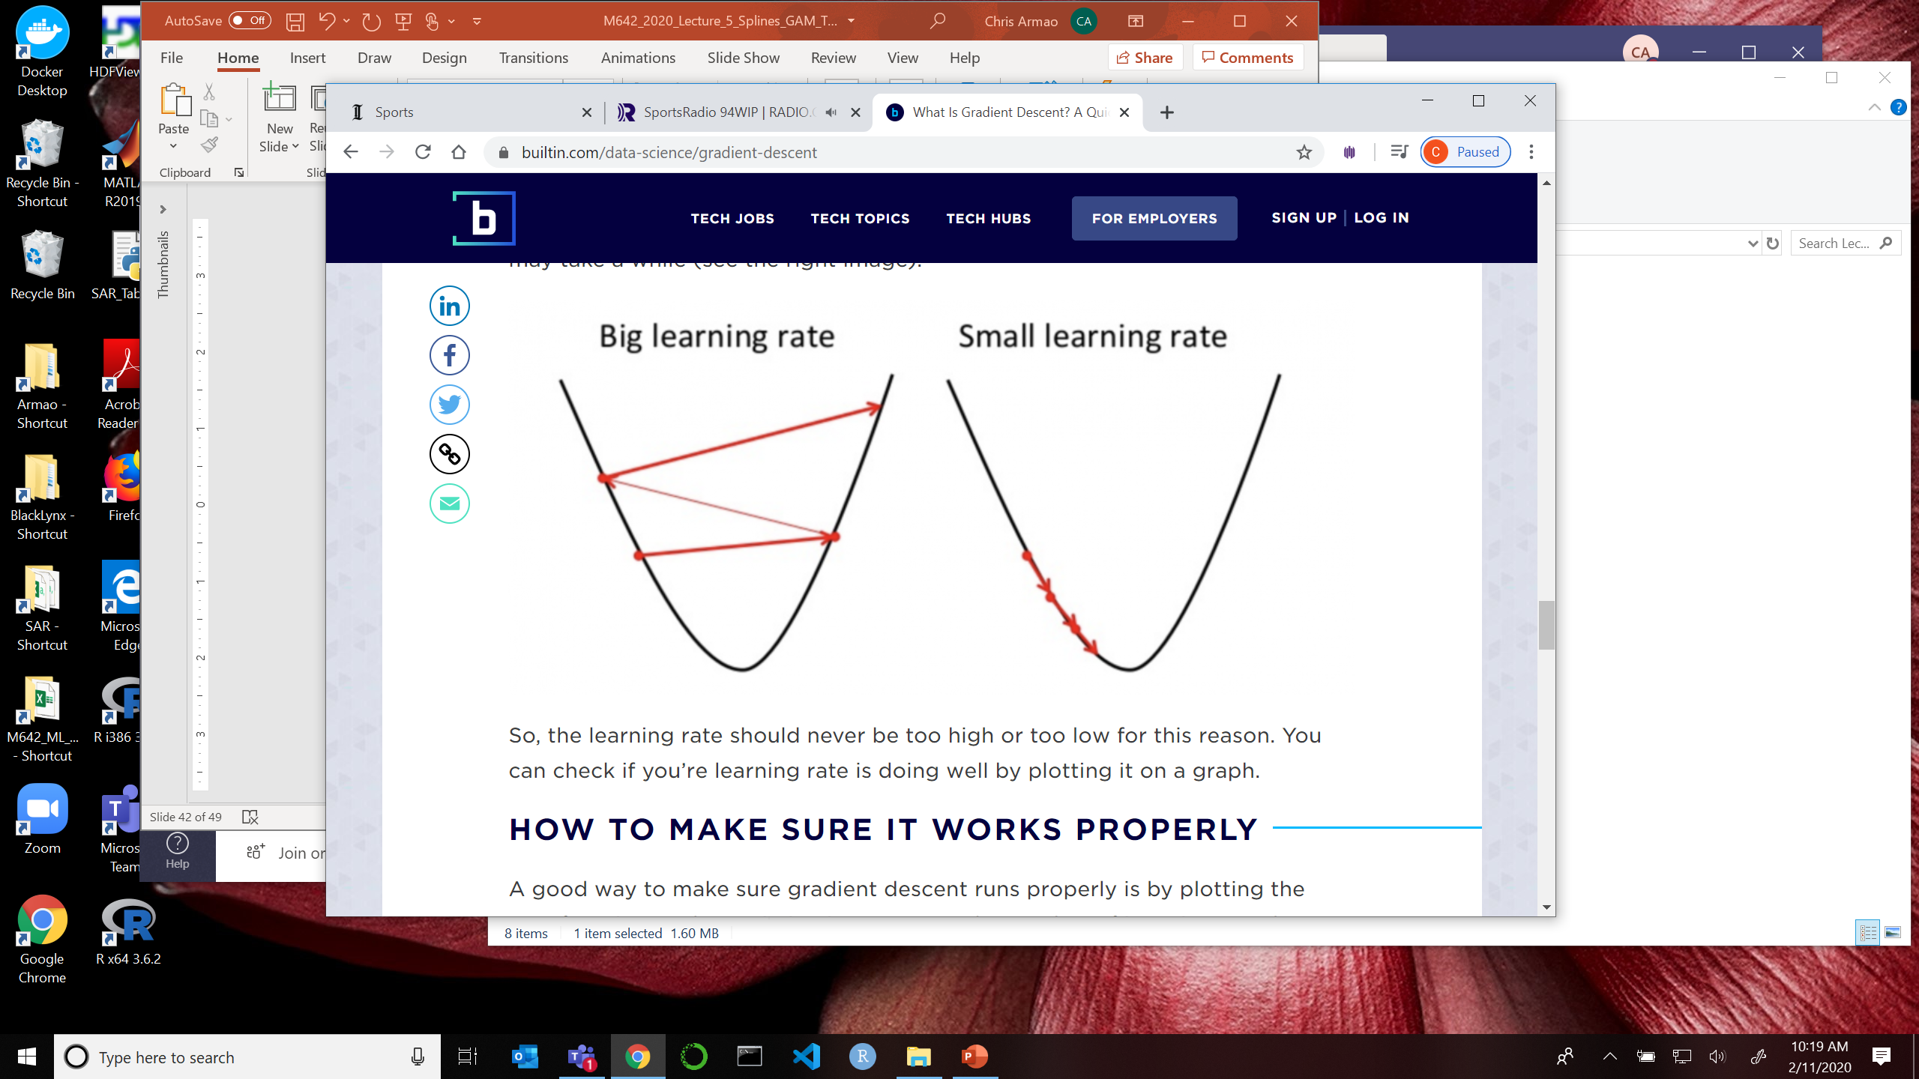
Learning Rate
We need a variable learning rate, γ, to make sure the algorithm is stable. It’s difficult to create an algorithm that works quickly but is stable under all conditions.
β_{new} = β_{old} + γ ∗ Δ ∗ (δJ / δβ)
Where Δ = step size
γ = learning parameter

Slide 50
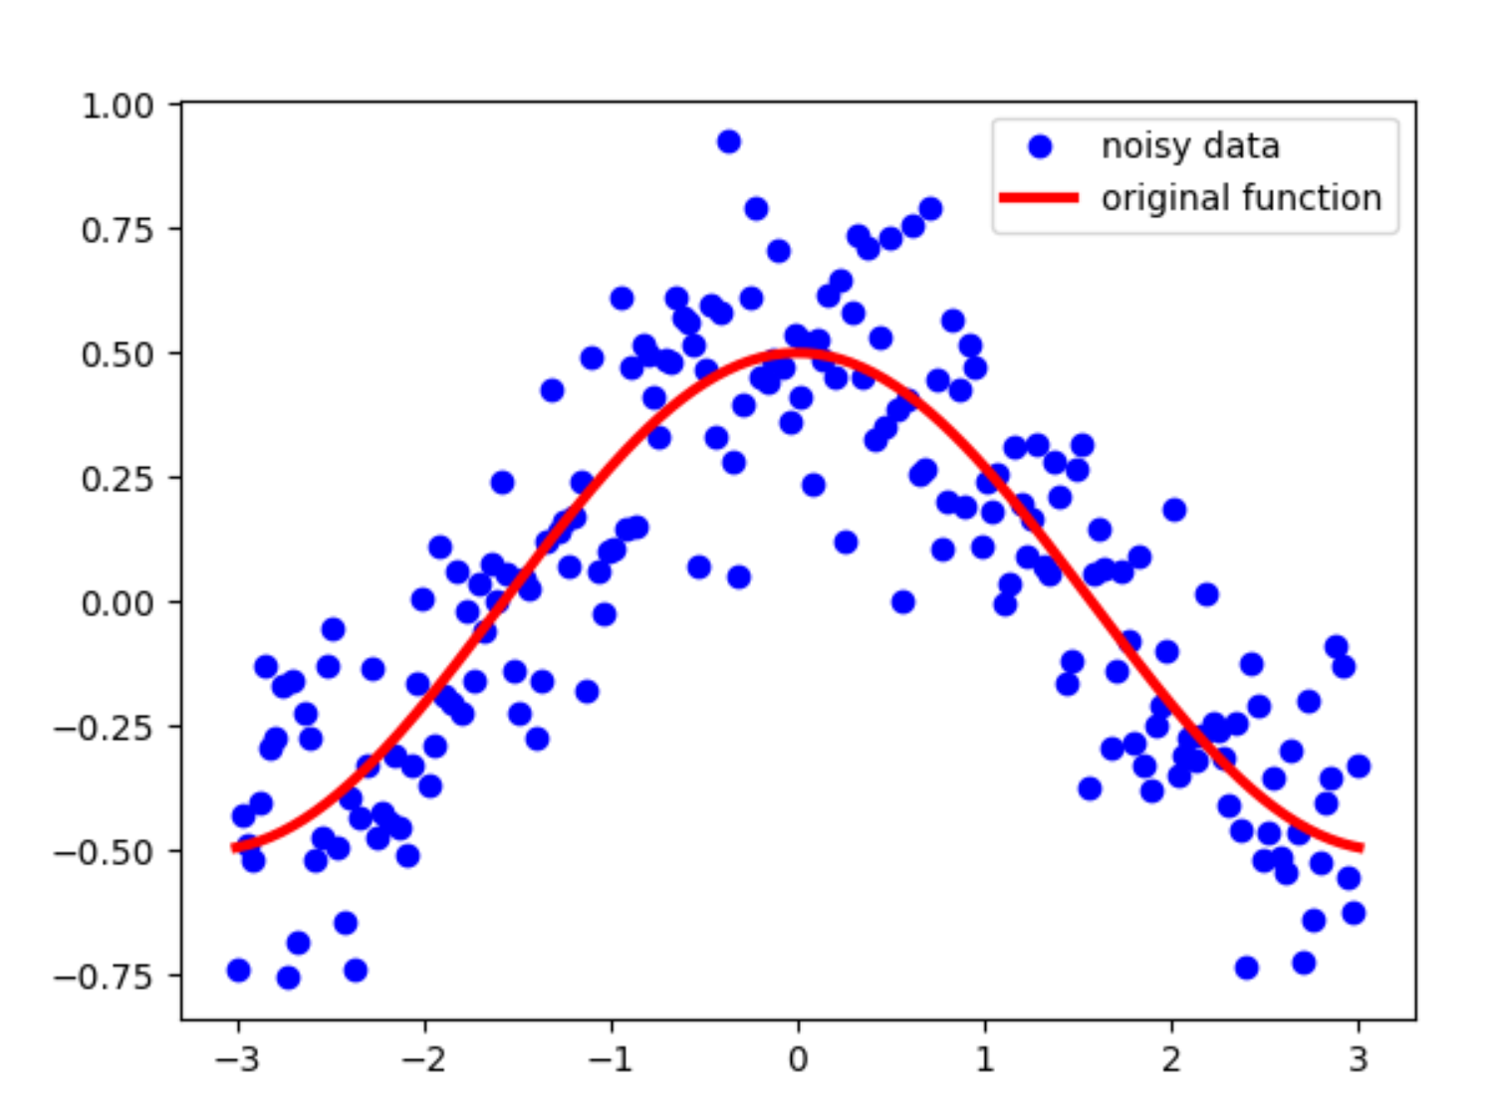
Implementation of Gradient Descent
Standard Gradient Descent – Use all your samples to find the minimum
Stochastic and Mini-Batch Gradient Descent - Sometimes the training set for many parameters is so large that it would take forever to examine all of it. In this case you can use M subsets of the data for training until the result converges.
Momentum Gradient Descent – Sometimes the Error Function can be excessively noisy. In these cases you can smooth the surface (for example, average each sample with k nearest neighbors) before applying GD.

Slide 51
Homework #5 (1 of 1)
Read Chapter 7 of ISLR, Pages 265 – 286 (skip classification)
Work through all of the R-labs in the text, pages 287 - 297
Do Chapter 7 Problem 2
Do Chapter 7 Problem 5
Do Chapter 7 Problem 9
Do Chapter 7 Problem 11
Write a Gradient Descent program in R to find the minimum of the equation.
y_{i} = (x_{i}² -9)²
(Note – don’t solve this by using the derivative of the equation above. Solve it by creating some samples and solving it numerically)
Apply splines to your project data. No need to hand this in now, save it for your final report.
Due Feb 17

